Slide 1
Google Trends as a Sentiment Indicator in Algorithmic Trading

Slide 2
Quick reminder
What is sentiment analysis ?
Sentiment analysis is the process of using natural language processing to identify, extract, and quantify subjective information from text, determining whether the expressed sentiment is positive, negative, or neutral.
Notes:
Sentiment analysis is the process of using natural language processing to identify, extract, and quantify subjective information from text, determining whether the expressed sentiment is positive, negative, or neutral.

Slide 3
tools
Google Trends
Glimpse
Python APIs – Pytrends, Binance

Slide 4
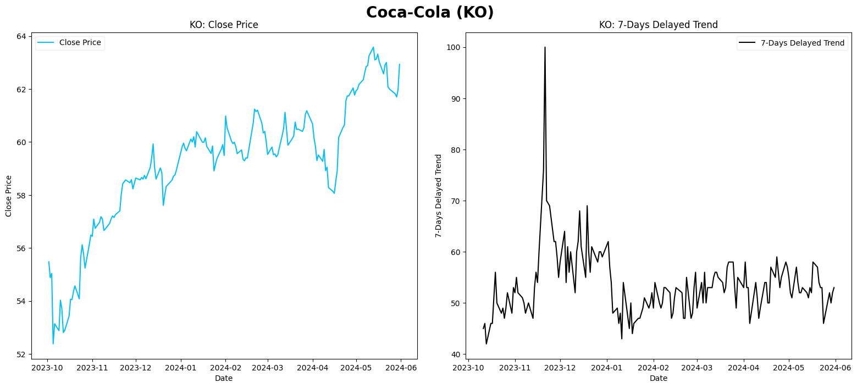
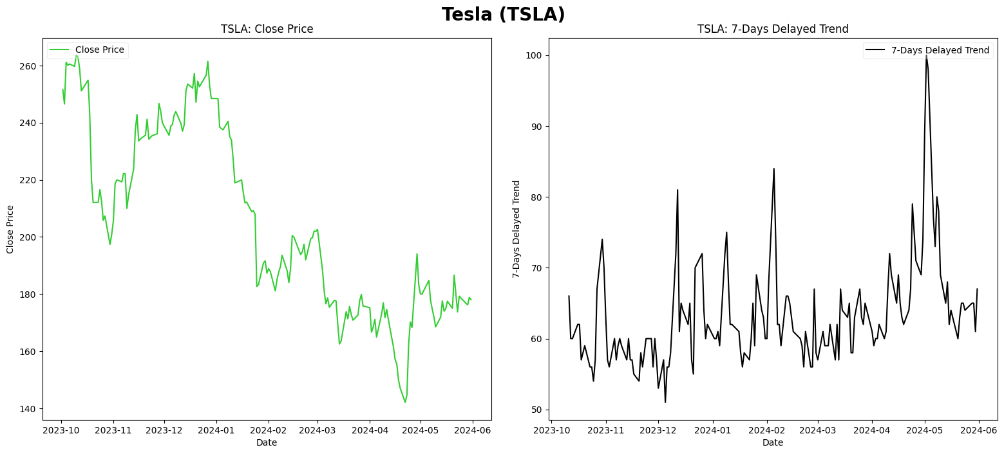
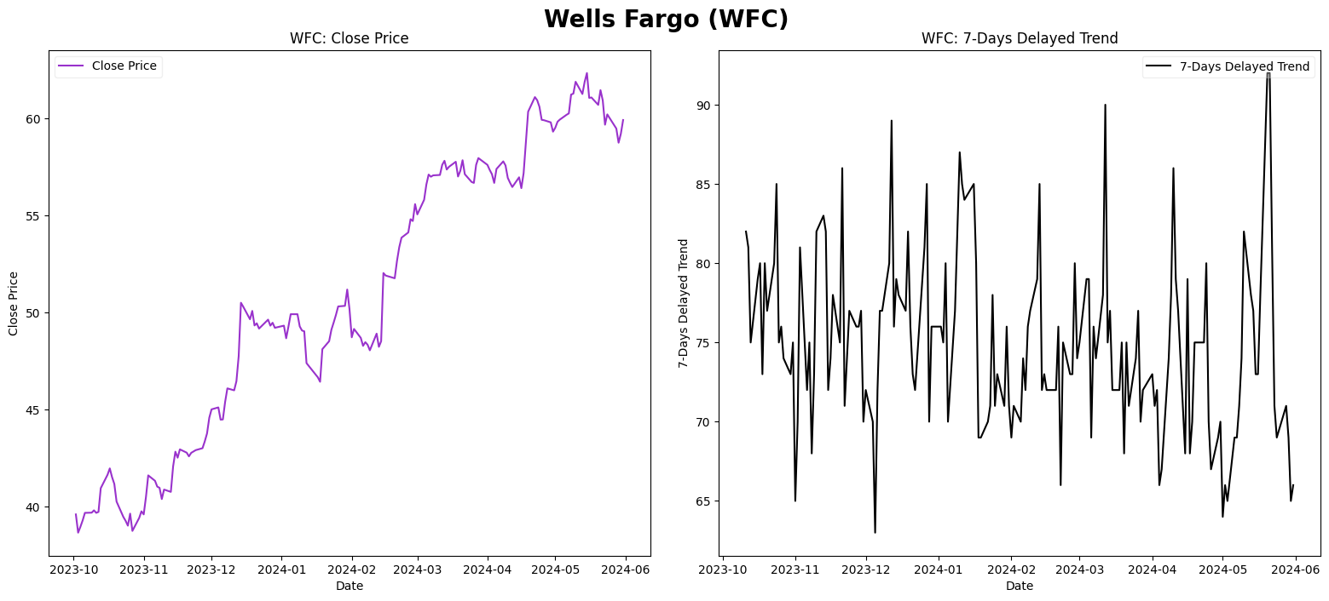
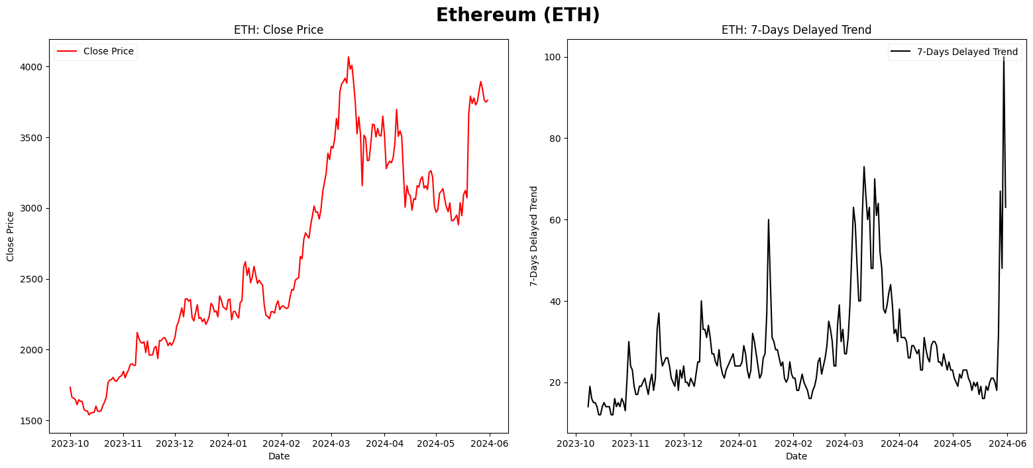
Evidence
Notes:
Remove?

Slide 5
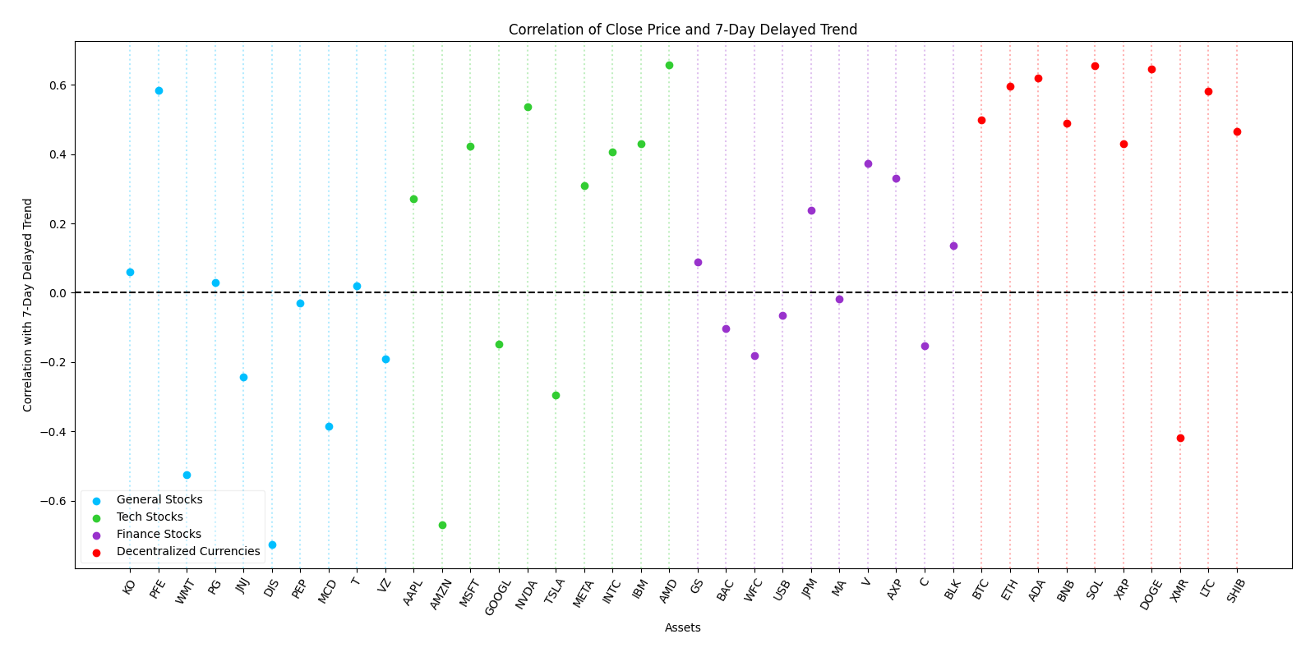
Evidence
The Crypto-Market has Higher Correlation to it’s Trend Compared to Other Sectors
Notes:
Remove?

Slide 6
What are we trying to achieve
Aka how we’re going to get rich
Simple idea, Complex Execution
Algorithm Monitoring
Performance Metrics
Comparison with Buy & Hold
Notes:
Original text:
Simple idea, hard fine tuning. Our algorithm monitors search trends and sentiment analysis of crypto currencies related keywords. When it detects a significant increase in search frequency for a stock, it signals a potential buy opportunity, anticipating a price rise. How exactly? Come check our code!
Bullet expansion:
Simple Idea, Complex Execution:
"Our goal is to create an algorithm that monitors search trends and sentiment analysis for cryptocurrency-related keywords."
Algorithm Monitoring:
"When the algorithm detects a significant increase in search frequency for a stock, it signals a potential buy opportunity, anticipating a price rise."
Performance Metrics:
"We evaluated the performance of various versions of our strategy, each with different hyper-parameters, to identify the best performing one."
Comparison with Buy & Hold:
"For comparison, we also implemented a simple Buy & Hold strategy and calculated its performance metrics to benchmark our results."

Slide 7
Data normalization
Data Collection Issues
Local Data Storage Solution
Notes:
Original text:
Data acquisition: First issue we encountered was getting the data consistently, at the start we found that google trends had some issues to generally produce data on search frequency, additionally, when temporarily google trends did produce the data it would not always succeed in returning requested data on every device due to internet network issues. To overcome that we saved relevant data locally on one of our computers and requested the data from a LAN connected device so connection to internet would get in the way of getting the data for the first time.
Bullet expansion:
Data Collection Issues:
"Initially, we faced challenges with consistently obtaining data from Google Trends. It was often unreliable due to network issues and device inconsistencies."
Local Data Storage Solution:
"To overcome this, we saved relevant data locally and requested it from a LAN-connected device to ensure a consistent data retrieval process."

Slide 8
Data normalization
Data Cleaning & Organizing
Using Glimpse for Approximation
Notes:
Original text:
Data Cleaning & Organizing: When we request the data from google trends through the website manually or through the python api the data we get in return is limited to be up to 270 samples each time, and each data set of 270 is normalized on itself using an internal method of google trends, in other words, we couldn’t get the real absolute quantity of searches and couldn’t calculate it by any reliable means. This poses an even greater issue since we couldn’t connect the datasets we could have got from google trends because the scale the samples are normalized to is different almost every time (rarely it could be of the same scale reliably). To solve that we used an additional tool, Glimpse, an addon for google trends that returns an approximated quantity of searches, since we used a total of 5 year timeframe, glimpse gave us weekly samples. Using the approximated quantity and the distribution of each data set from google trends we were able to approximate a reliable enough data set containing daily samples of continuous nature. After doing so we normalized all the data to be from 0 to 100
Bullet expansion:
Data Cleaning & Organizing:
"The data from Google Trends is limited to 270 samples, each normalized individually. This made it difficult to connect datasets due to differing scales."
Using Glimpse for Approximation:
"We used Glimpse to obtain approximate search quantities over a five-year timeframe, providing us with weekly samples. This allowed us to create a reliable dataset of daily samples, normalized from 0 to 100."

Slide 9
Strategy & backtesting
Granger Causality Test
Filtering Coins
Signal Calculation
Portfolio Updates
Performance Metrics
Comparison With Buy & Hold
Notes:
Original text:
The strategy is based on a granger causality test for each coin to determine how much delay should be set for the normalized trends data to gain the maximum plausible causality of the trends data on the price data.
Additionally, we filtered out coins that the granger causality said that their maximum plausible causality delay isn’t plausible enough (Hyper Parameter: maximum P-value allowed from the granger causality test).
Than for each coin separately we calculated the signals to buy and sell, where the buy and sell signal are determined through the use of Bollinger bands on the normalized trends data (Hyper Parameters: MA window, amount of sd added to upper band and amount of sd subtracted from lower band) and through the use of RSI on the Close price of the coin (Hyper Parameters: RSI window and RSI limits) as a limiting force for the Bollinger bands when the prices of the coins become too noisy and therefor too risky to trade.
After that we connect the data of all of the coins and order the samples by their dates and apply the signals.
When there is a Buy signal we compute using the balance, a scaling number (Hyper Parameter: quantity scale) and the ratio of the normalized trend with the upper band of the Bollinger bands how many of the current coin to buy, and using the Open and Close prices of the coin the price of that coin using slippage correction over the Open price. It is important to mention that after the buying action using the quantity calculated the value of the portfolio is updated.
When there is a Sell signal we sell all of the held amount of that coin up until that date, that amount is sold as well with the price that was calculated using slippage correction over the Open price. It is important to mention that after the selling action using the quantity calculated the value of the portfolio is updated. Originally the Quantity sold of a particular coin was calculated in a similar way to how it is calculated for the Buy signal, but due to many results from the backtesting we determined that it is best and most efficient to always sell all when a sell signal is given.
When there is no Buy or Sell signal the value of the amount of the coin held, is updated in the value of the overall portfolio, again, using the price calculated using slippage correction over the Open price.
Finally, after all of that we calculated for each version of this strategy (a version is this strategy with a different set of Hyper-Parameters) performance metrics to evaluate and find which version performed the best.
Additionally, we made a comparison strategy with the simple methodology of Buy & Hold (A.K.A. Hoddle) and calculated its performance metrics as well for comparison.
Bullet expansion:
Granger Causality Test:
"We applied a Granger causality test to each coin to determine the optimal delay for trends data to influence price data."
Filtering Coins:
"Coins with insufficient causality delays were filtered out to ensure reliability."
Signal Calculation:
"Buy and sell signals were determined using Bollinger bands and RSI. These signals were based on the normalized trends data and the coin's close price."
Portfolio Updates:
"We updated the portfolio's value based on buy and sell actions, considering slippage corrections and re-evaluating the balance after each transaction."
Performance Metrics:
"We calculated performance metrics for each strategy version to identify the best performing set of hyper-parameters."
Comparison with Buy & Hold:
"For comparison, we also evaluated a simple Buy & Hold strategy and calculated its performance metrics."

Slide 10
Results & Discussion
Showcase results and discuss on them

Slide 11
Any question?

